Slide 1


Hello Friend!
At the beach thinking about Digital Footprints! The waves never wash them away. Wish you were here!
Christina DiMicelli
To:
Spring 2012 Explorations in Mind, Brain, & Teaching
Re:
A Brain-Targeted Teaching Unit
Focus: Digital Footprints
Time: 9 classes (50 mins each)
Grade: 7
Standards: ISTE NETS*S
Digital Citizenship
Creativity & Innovation
Technology Operations/Concepts
NH Visual Arts K-12, Standard 6
Connections to daily life w/visual arts
Notes:
Hello Friends,
My name is Christina DiMicelli and I teach computer/technology classes to middle school students.
This unit covers the concept of Digital Footprints over a period of 9 classes to 7th graders, although you could certainly modify it to other age groups.

Slide 2

DIGITAL FOOTPRINTS are the trail you leave behind online.
What digital footprints do YOU have?
School Website
E-mail
Facebook
Linkedin
Notes:
A digital footprint is the trail you leave behind online. Think about all the places you visit online, the photos you upload, the comments you write. These are your digital footprints.
These footprints do not get washed away by the waves. They are permanently associated with your online indentity.

Slide 3
Middle School students are active digitally, especially in social media.
In this unit, they will learn about:
Netiquette
Digital Citizenship
Digital Footprints
Online Privacy
CAUTION
Watch U Privacy!
Notes:
Middle school students are very active on the internet and are beginning to experiment more deeply with social media. They may be unaware that every action taken on the internet leaves a footprint that is digitally connected to their identity. In this unit of study they will learn about what digital footprints are and review where online they are leaving their own set of footprints.
Through art integration projects, students will physically feel the process of creating footprints. They will also create their own avatars (visual representation of themselves) and connect these to online safety procedures. Online games will reinforce the content regarding digital citizenship. The students will come together to create a large mural-like poster containing their collaborative “digital pledge”. Finally, in a move to “pay it forward”, students will create audio PSAs (Public Service Announcements) for our Lower School students.

Slide 4

BT1 – Emotional Climate for Learning
The online world is EMOTIONAL for students!
Teacher
Brings personal experiences to discussion
Students
Collaborate on responsibility to each other online
Use voice & mood music to teach younger students
Identify self with avatars & painted feet
Notes:
Brain Target 1 is about emotional connection and the online world is an emotional one for students.
The teacher will capitalize on that by bringing personal experiences to classroom discussions.
Interacting with others online are powerful emotional triggers. Through activities, students will identify how to be responsible digital citizens. They will use their own voices and mood music choices to teach younger students.
The physical painting of feet to create footprint banners can evoke emotional connections as can the creation of their own avatars.

Slide 5

BT2 – Physical Learning Environment
The classroom will reflect the topic & student work.
On the classroom walls
Big picture road map
Footprint banners
Avatars
Digital Pledge Mural
Bulletin board w/relevant articles
Beach themed borders
Beyond the classroom
Digital Pledge Mural shared with younger students
Notes:
Brain Target 2 entails the physical environment.
For this unit there are several activity products that will hang on the walls.
The unit also allows for movement throughout the lessons as opposed to just sitting at a computer station for the entire period.
Beyond the classroom, we will share the Digital Pledge Mural with younger students and encourage their participation.

Slide 6
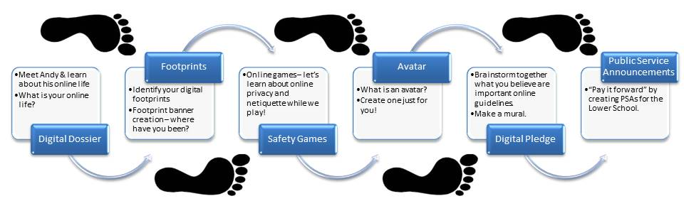
BT3 – The Learning Experience Design
Where do we start? By showing the road map.
Goals relate to
Digital footprint concept
Digital identity
Internet safety & netiquette
Notes:
Brain Target 3 is about prior knowledge, goals, and a vision of how it all comes together.
A strong visual road map will be introduced to students and hung on the wall for reference.

Slide 7
Introductory Activity
Discussion of phrase “digital footprint”
  (write key points on whiteboard)
Watch video “Digital Dossier” & think-pair-share
Discussion online privacy & netiquette guidelines
  (write key points on whiteboard)
Brainstorm personal digital footprints
  (students create list)
Ticket out the door
Checking for Fog
Notes:
In order to assess prior knowledge:
Ask students if they have heard of the phrase “digital footprint” and ask for input as to what they believe it could mean. Write key points on whiteboard and come to a class consensus on the definition.
Watch the video Digital Dossier regarding Andy and his life (birth to death) from a digital standpoint. Students think-pair-share regarding the question “how aware are you of the digital tracks you leave behind?”
Overall class discussion regarding how to protect privacy online and netiquette guidelines follows with key points on whiteboard.
Students brainstorm, individually, a list of all the tracks they leave behind and create a recording of their personal digital footprints.
Checking for Fog – Ask students to write on a piece of paper what part of the activity was most unclear (foggy) to them as their “ticket out the door”.

Slide 8
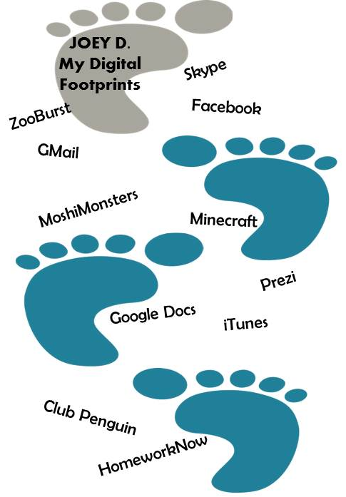
BT4 – Mastery of Declarative / Procedural Knowledge
A variety of activities and repeated rehearsals to help students master the skills and content of the unit topic.
Activities
Footprint banner creation
Online Games
Avatar creation
In Progress
Students get
Messy
Personal
Creative
Art Integration
Notes:
Brain Target 4 brings us to teaching for the mastery of declarative/procedural knowledge.
In this unit, students will use their lists of digital footprints from the Introductory Activity brainstorming to create a footprint banner. They will be in the Art Studio putting paint on bare feet and feeling their footprints!
The online games are from the Media Awareness Network and focus on netiquette and online privacy. This will give them some repetitive hands-on exploration of the topic in a fun game form.
Finally, students will create digital representations of themselves as avatars. This is an activity that is personal and connects students directly to the topic.

Slide 9

BT5 – Extension / Application of Knowledge
Activities bringing real-world context, analysis, and a chance to investigate the topic more thoroughly.
Activities
Digital Pledge Mural
Audio PSAs
(Public Service Announcements)
Students design a Digital Pledge, share with younger students, and encourage participation. Audio PSAs are also created for this audience.
Notes:
Brain Target 5 has students applying their knowledge and extending it into a real-world context.
Students will collaborate on a Digital Pledge. In conjunction with the Art program, they will create a moveable wall mural that incorporates the pledge, their handprints, and signatures.
Next they will create audio PSAs for the younger students in our school. In pairs they will choose a specific sub-topic from the unit, use their voices to communicate, and choose background mood music. It is a personal, emotionally-connected, and real-world activity.
When the PSAs are delivered to the younger students, the mural will follow to their hallway and they will be encouraged to participate in the pledge.

Slide 10
BT6 – Evaluating Learning
Utilizing a variety of tools throughout the activities, learning is evaluated with fast, relevant feedback.
Assessment
Introductory “Big Picture” Activity
Checking for Fog – Ask students to write on a piece of paper what part of the activity was most unclear (foggy) to them as their “ticket out the door”.
Footprint Banner
Student self-assessment
Checklist (developed in conjunction with Art teacher)
Online Games
Back-to-Back – In pairs students stand back-to-back, each with notebook and pencil. The teacher asks a question regarding the topic and students write answers in the notebooks. Teacher will instruct students to turn around, show partner answers, and discuss.
Avatar
Slogan – Ask students to create a slogan that captures the main idea of the activity and matches their avatar.
Digital Pledge Mural
Checklist (developed in conjunction with Art teacher)
Student self-assessment
Audio PSAs
Student self/group assessment
Peer reviews
Rubric
Storyboard
Culminating
Reflection survey – students complete an online survey that contains reflection prompts and questions regarding the unit topic and activities
Notes:
Brain Target 6 has us evaluating the learning throughout the unit in a variety of methods.

Slide 11

Brain-Targeted Teaching Unit
The BTT Template for this unit is available for use and/or modification.
Extension Activity for you:
Do you know what your Digital Dossier looks like? This video shows us Andy and the timeline of his life as measured digitally.
Notes:
Thank you for taking a look at my Brain-Targeted Teaching Unit on Digital Footprints. The unit is available for your use and/or modification.
I have made available for you as an extension activity (it’s not mandatory) the video Digital Dossier.

